Slide 1

BTS Infrastructure
Erin M. Buchanan

Slide 2


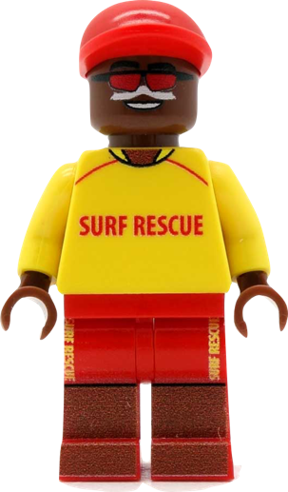
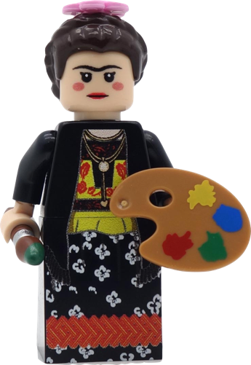

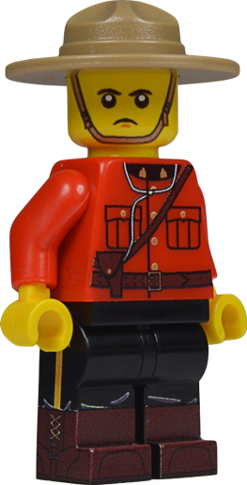
Big Team Science
Notes:
The growth of big team science has also led to growing pains for understanding how to manage and coordinate projects.

Slide 3

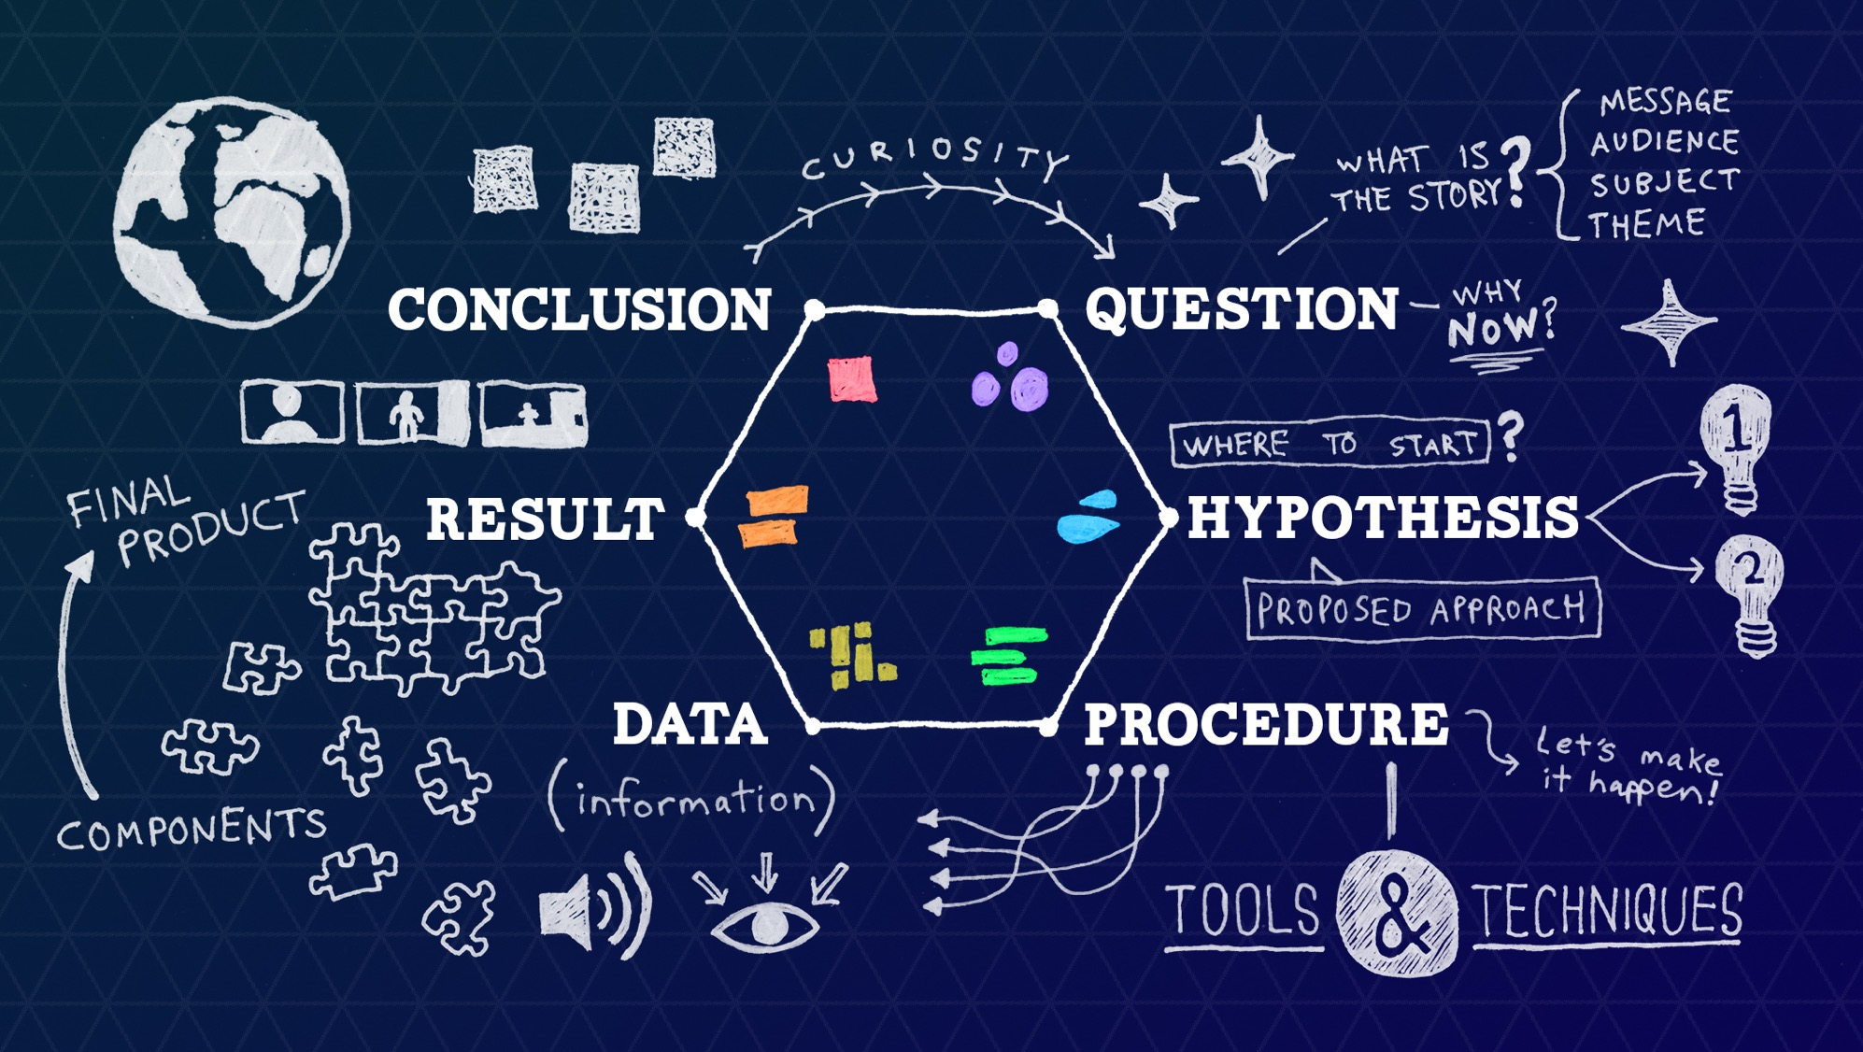
Notes:
In the traditional science process, you might follow these steps to work on an individual project.

Slide 4
Big Teams = Big coordination
Many researchers = lots of coordination
Multiple IRBs
Multiple teams
Multiple roles
Emails change
Tracking progress
And so on…

Slide 5
How to manage?
Using a lot of Google docs!
Difficult to know best set up
People could edit … which can be bad
Team set up isn’t always easy to do in a data sheet
Cross coordinating different components

Slide 6


What if …
We could treat BTS like a business
Projects have hierarchies
People have tasks
Lots of business project management software available

Slide 7
What if …
Business thinking treats tasks as one and done
Roles are often strictly defined
Separation of task/role is easier

Slide 8
Instead what if …
We could treat BTS like a CLASS
Using a learning management system
Each person can have both group and individual roles
Assign tasks to both teams and individuals
Tracking CRediT through “assignments”
Improved communication through automatic archival

Slide 9
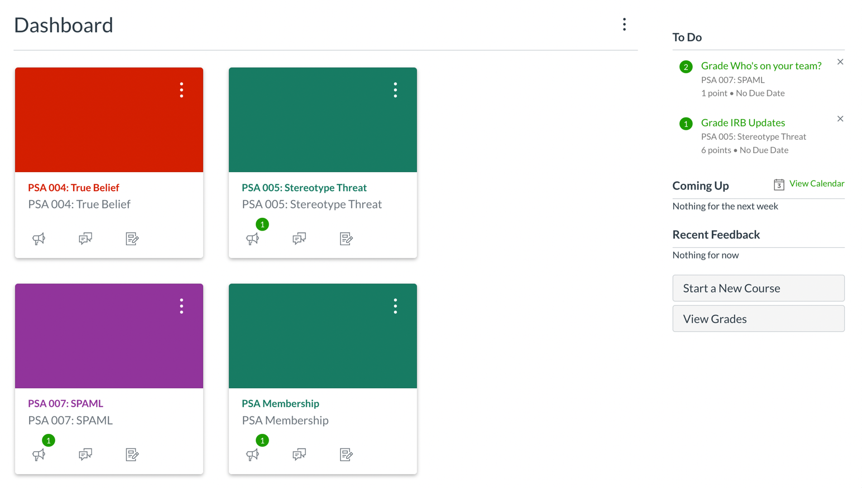
A walk through LMS BTS
Notes:
Each project is treated like a class in the LMS

Slide 10
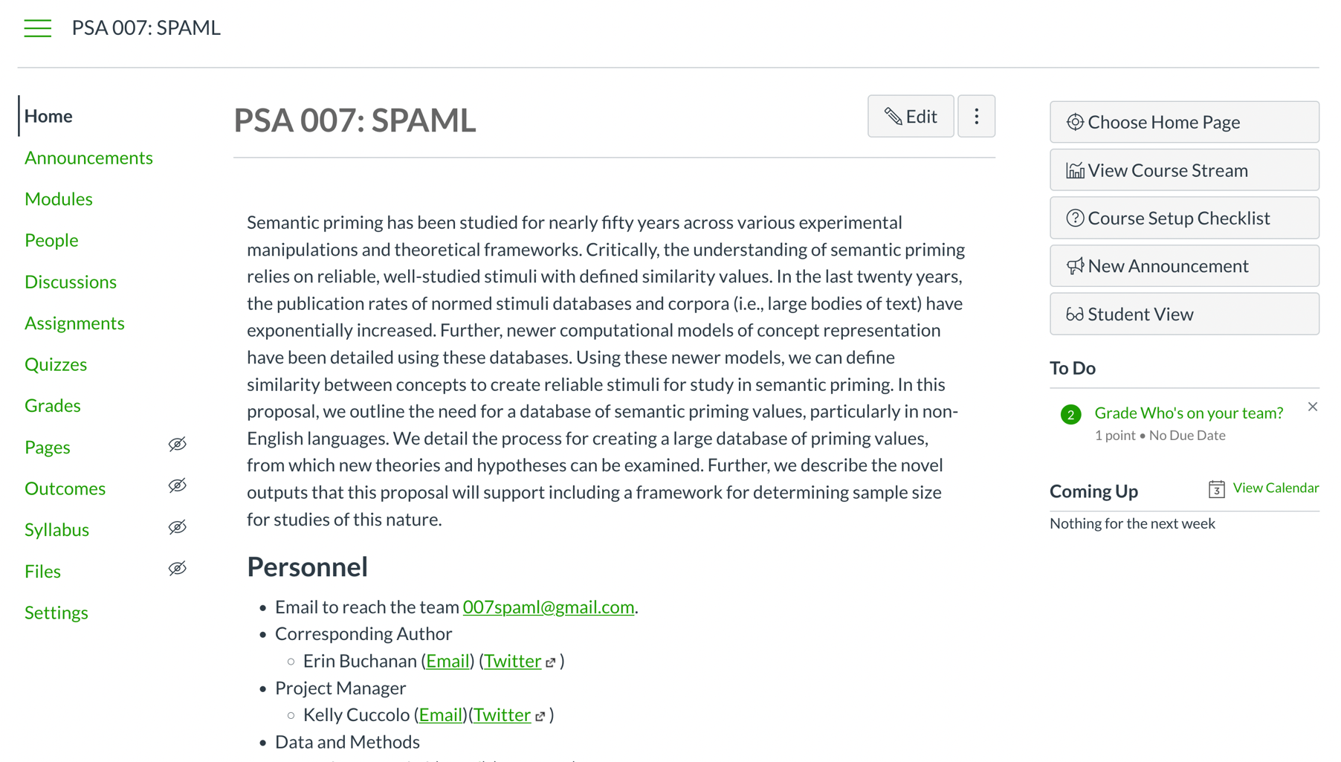
Notes:
Each project can have a home page to host relevant information, also see tasks for a person to do on the right hand side

Slide 11
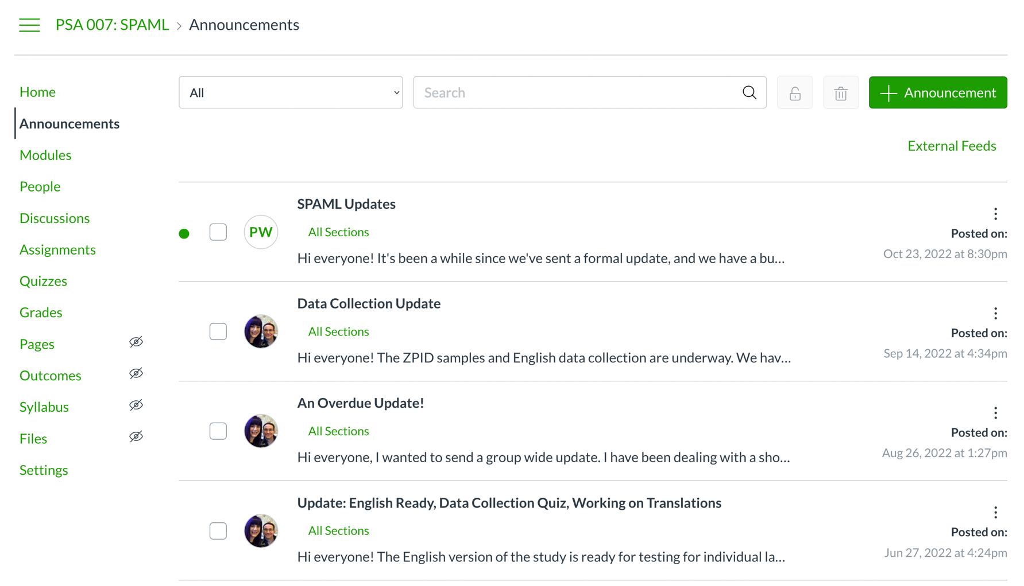
Notes:
The announcements features allow you to email everyone at once without worrying about leaving someone off, copying things wrong.
Also keeps an archive for all members to go back through.

Slide 12
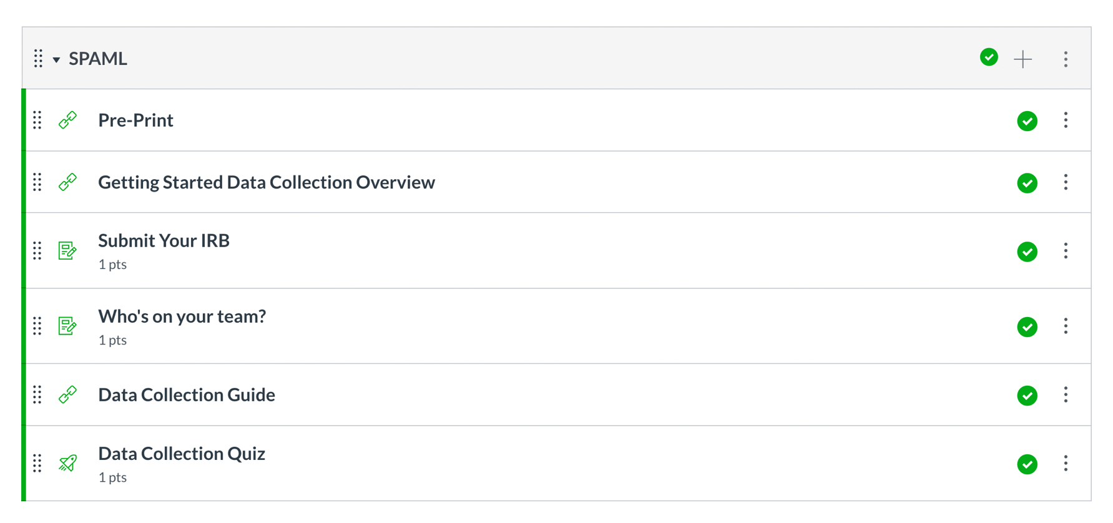
Notes:
Instead of an endless set of google forms that you might lose the links to we can use assignments to collect information we need from people

Slide 13
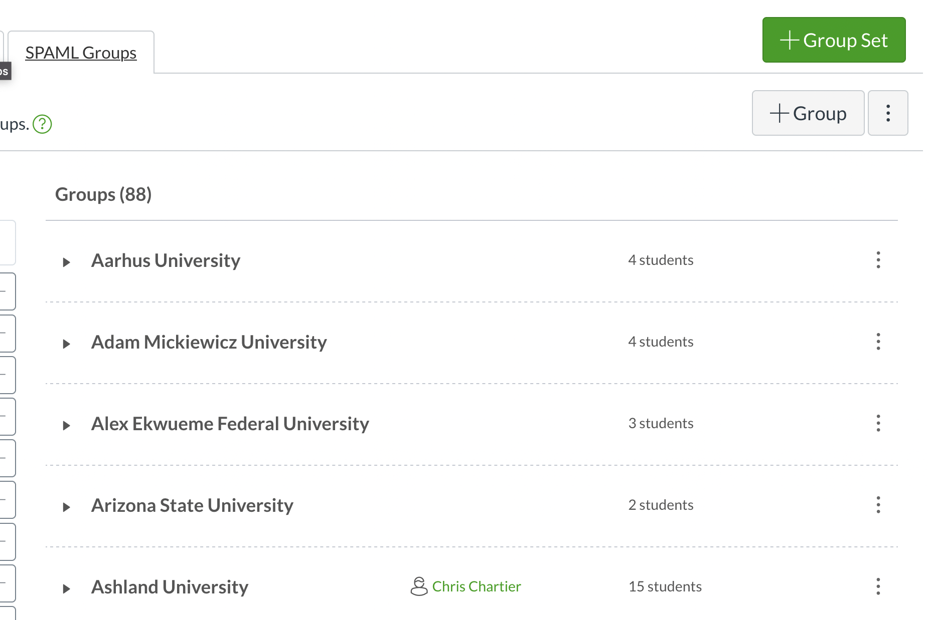
Notes:
Specifically, to deal with things like the IRB where you only need one thing, we can use groups
So when one person gets credit, they all get credit
But then for items that should be separate you can assign to one person at a time.
Bonus! This can be anyone on the team who does the work

Slide 14
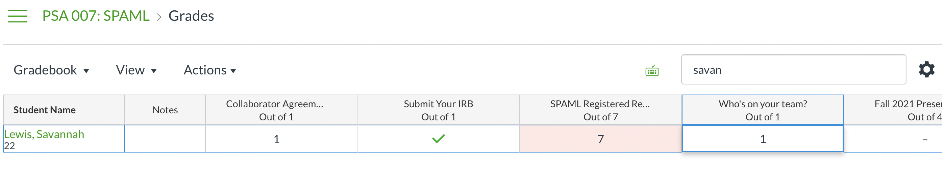
Gradebook = Tracker

Slide 15
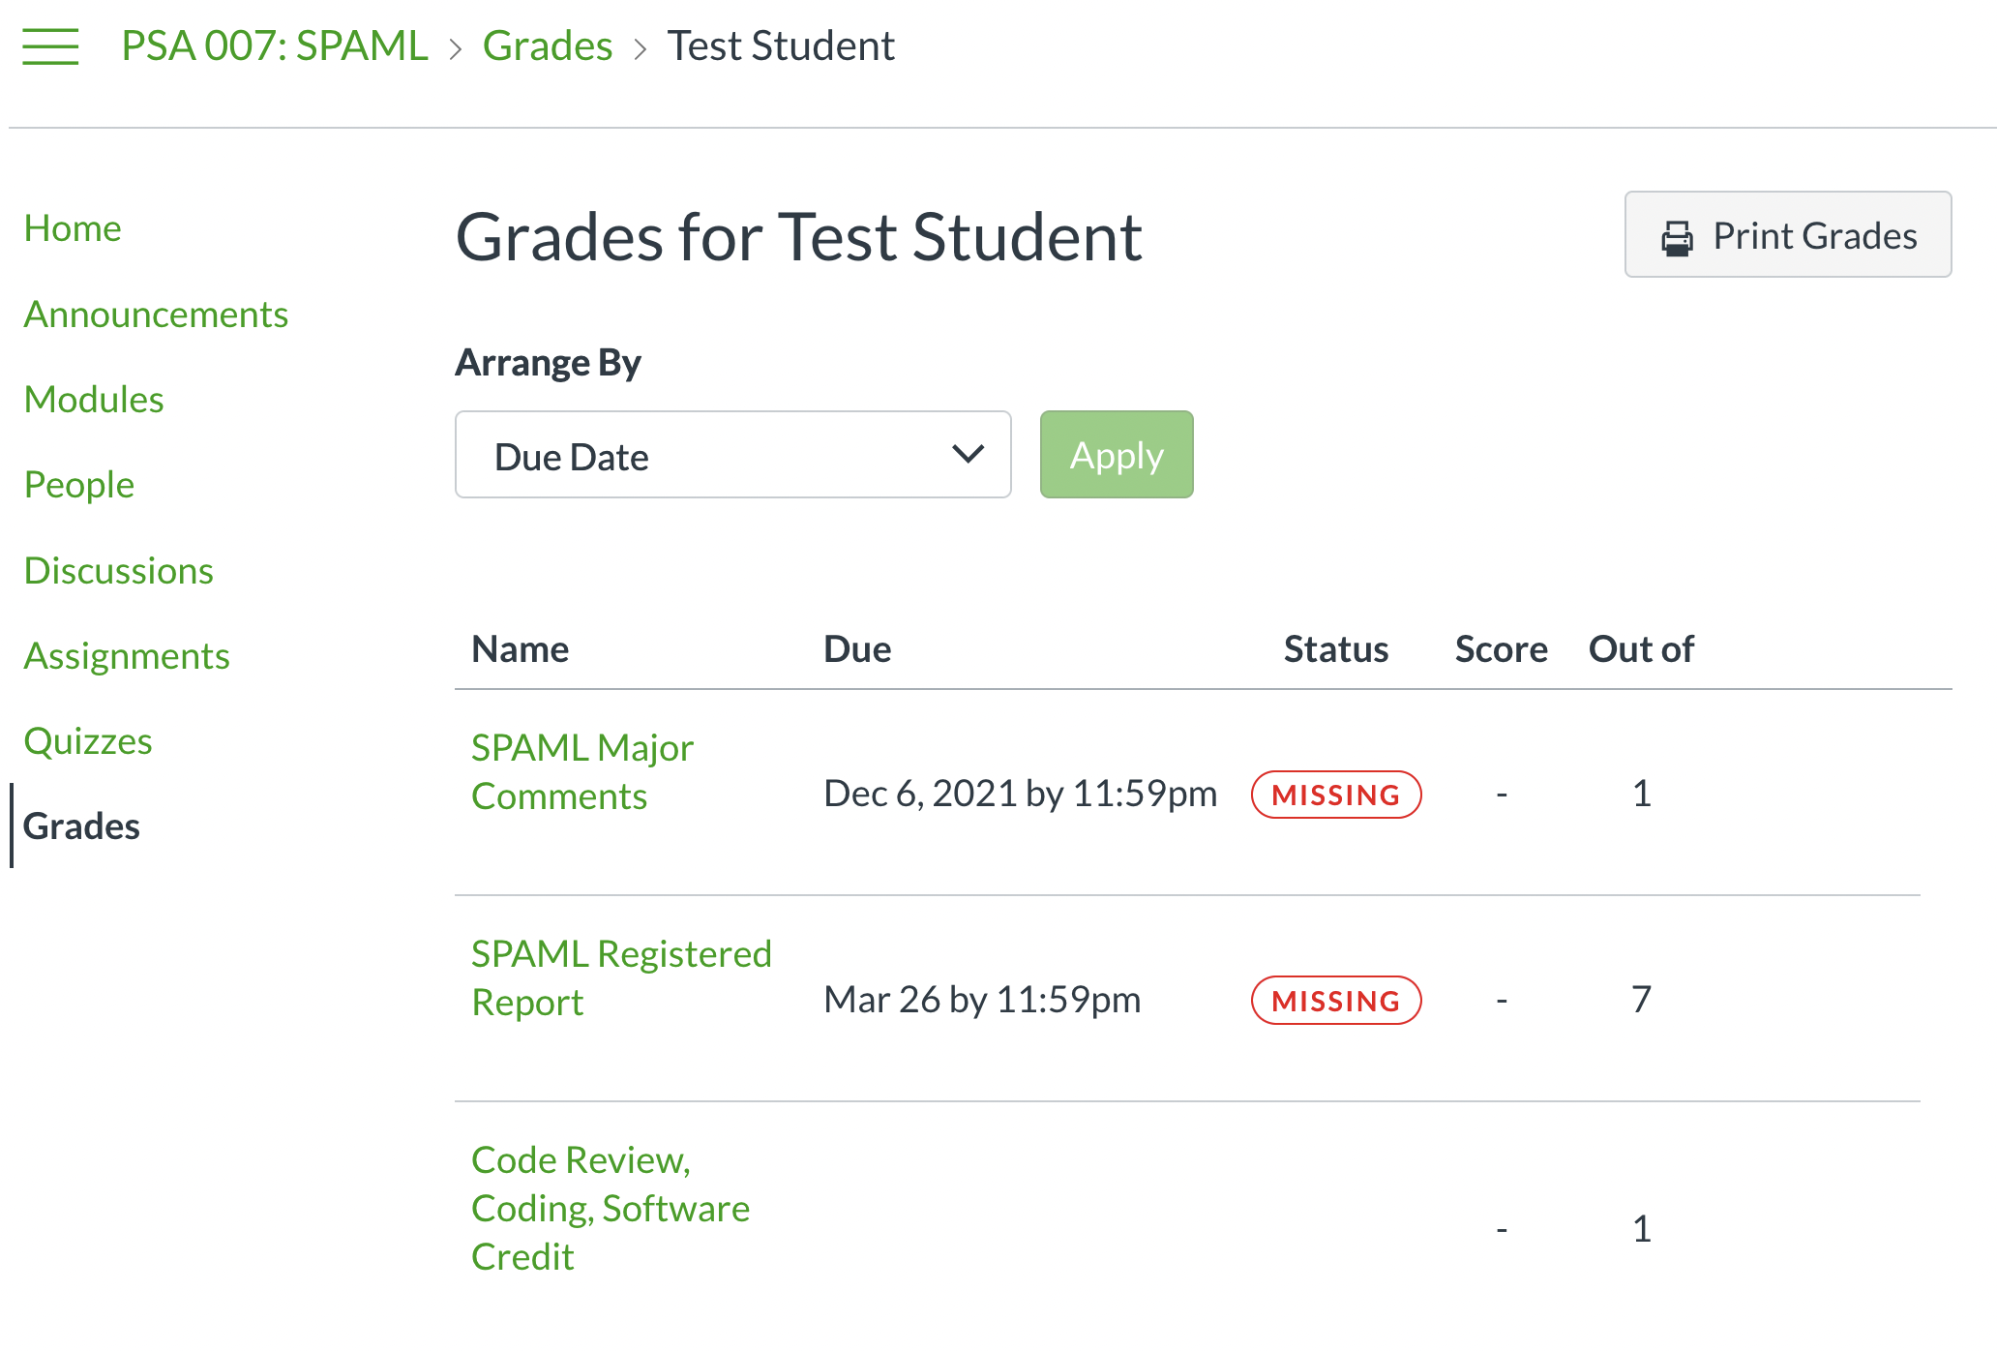
Notes:
Did I do the thing, did I get credit for the thing

Slide 16
Meta Science
Using a platform in which each person is uniquely identified
Allows for tracking across projects
Allows us to understand who participates

Slide 17
Growing pains
Canvas is open source but difficult to set up
Documentation is sparse
Not all the features we’d want, but at least many that are useful
Hosting / upkeep management can be frustrating
Community buy in

Slide 18

Thanks!
Big thanks to all the folks who’ve supported this idea
Questions?

